Slide 1
The wager of trust: Formation beyond accountability
Barbara J. Blodgett

Slide 2
My four claims
that trust may be defined as accepted vulnerability;
that to trust others is to learn how to be in a particular kind of moral relationship with them;
that trust is thus richer and more complex than simply holding someone accountable; and
that one way to form our students into ethical ministers is to trust them.

Slide 3
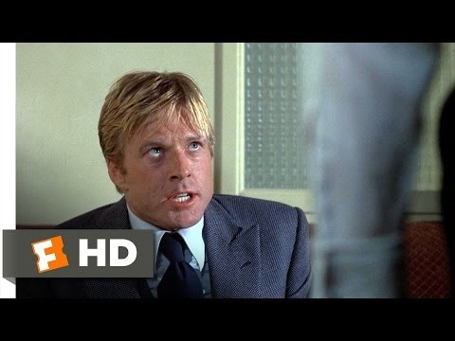
The sting

Slide 4
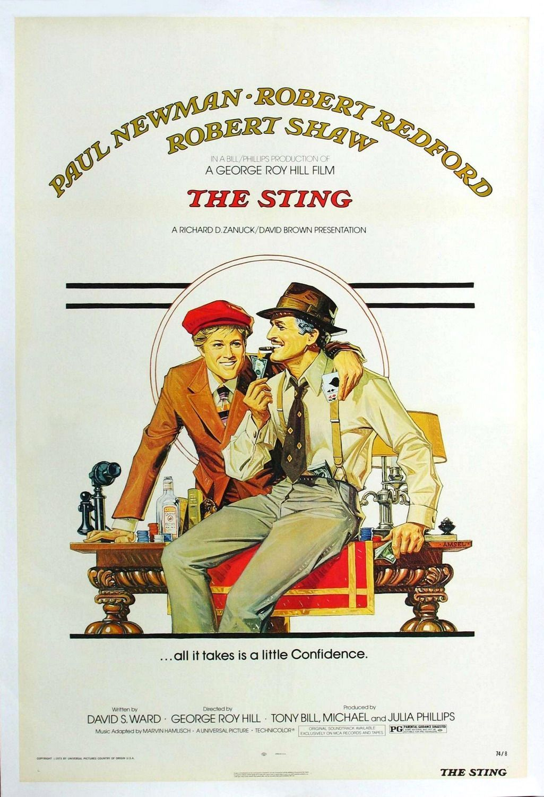
Learning about trust from con artists

Slide 5
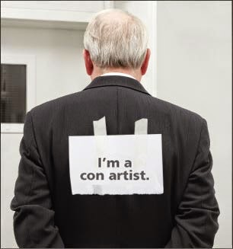
Credentials are a start, but not enough

Slide 6
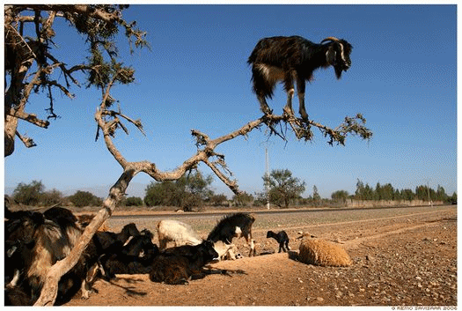
The riskiness of trust

Slide 7
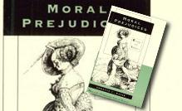
Annette baier on trust

Slide 8

Mutual vulnerability and trust

Slide 9

trustworthy, or accountable?

Slide 10
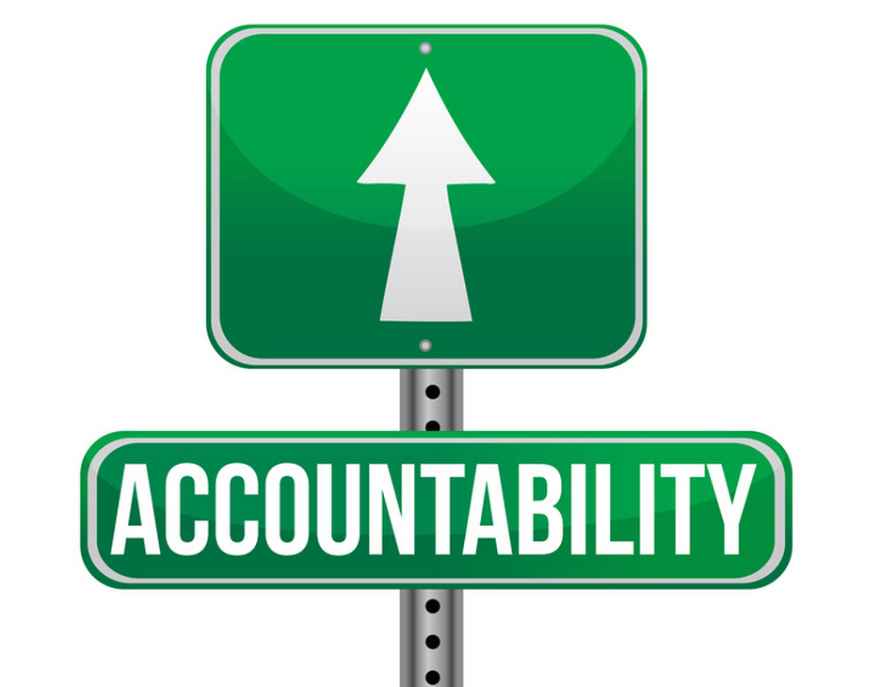
Accountability is trust one step removed

Slide 11
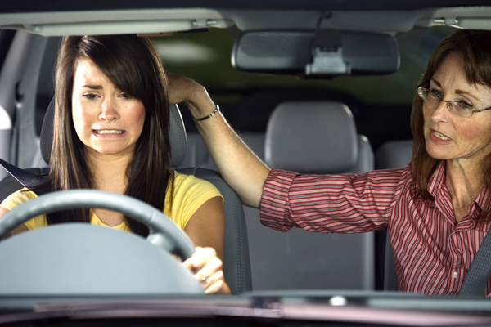
Trust them

Slide 12

Treating students as adults

Slide 13
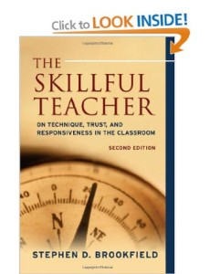
Stephen Brookfield, The skillful teacher

Slide 14

authenticity

Slide 15

Summary: The wager of trust in field education

Slide 16
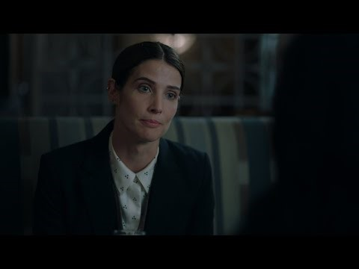
stumptown

