Slide 1
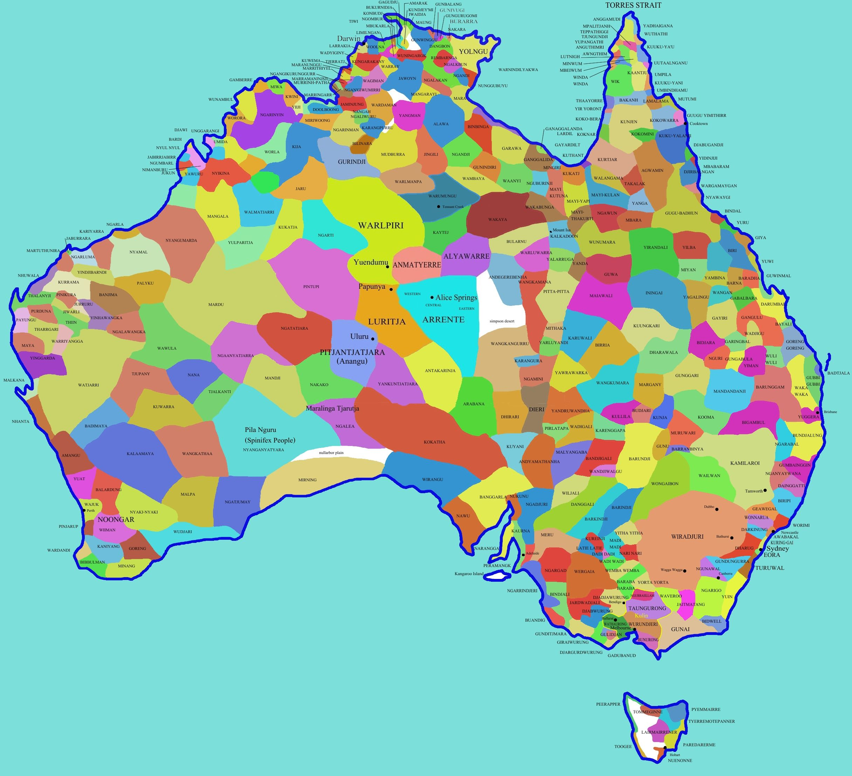
National Catholic Professional Standards: Australia

Slide 2
Website: www.cpsltd.org.au/
'How-to' guide for engaging children & young people
in conversations about safeguarding
https://www.cpsltd.org.au/media/1482/a-how-to-guide-for-engaging-children-and-young-people-in-conversations-about-safeguarding.pdf

Slide 3
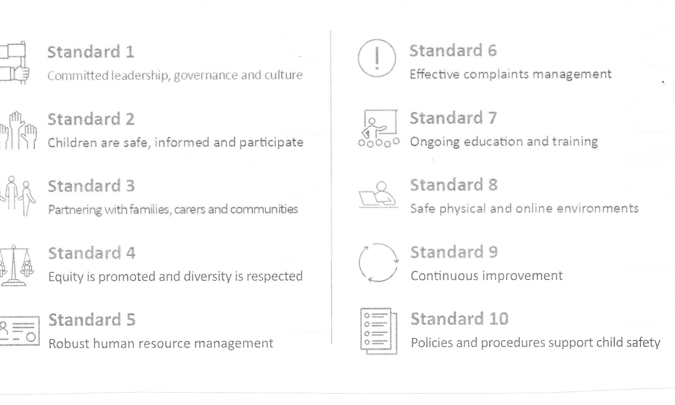

Slide 4
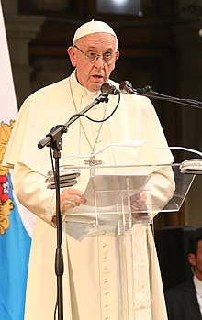
STANDARD 1
Committed leadership, governance and culture
Criterion 1.1 The entity public commits to child safeguarding and
takes a zero tolerance approach to child abuse.
Criterion 1.2 A child safeguarding culture is championed and
modelled at all levels of the entity from the top down
to the bottom up.
Criterion 1.3 Governance arrangements facilitate implementation
of Child Safeguarding Policy across the entity’s
activities
Criterion 1.4 A Code of Conduct provides guidelines for personnel
on expected behavioural standards & responsibilities
Criterion 1.5 The entity has risk management strategies focussing
on preventing, identifying and mitigating risks to
children.
Criterion 1.6 Personnel understand their obligations on information
sharing and record keeping

Slide 5
STANDARD 2
Children are safe, informed and participate
Criterion 2.1 Children are informed about their rights,
including safety, information and participation.
Criterion 2.2 The importance of friendship is recognised and
support from peers is encouraged helping
children feel safe and less isolated.
Criterion 2.3 Where relevant to the setting or context,
children and families may be offered access to
abuse prevention programs and related
information that is age appropriate.
Criterion 2.4 Personnel are attuned to the signs of harm and
facilitate child-friendly ways for children to
express their views, participate in decision-
making and raise their concerns.

Slide 6
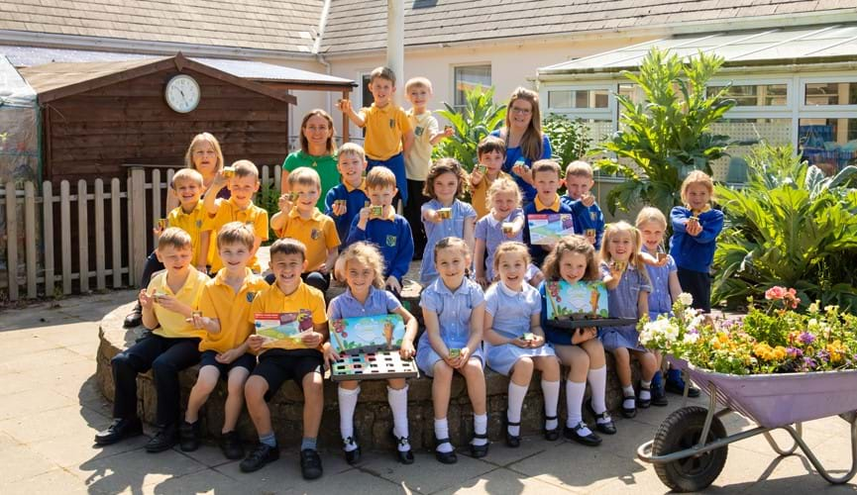
STANDARD 3
Parenting with families, carers and communities
Criterion 3.1 Families and carers participate in decisions
affecting their child.
Criterion 3.2 The entity engages and openly communicates
with families, carers and communities about its
child safeguarding approach and relevant
information is accessible.
Criterion 3.3 Families, carers and communities have a say in
the entity’s policies and practices.
Criterion 3.4 Families, carers and communities are informed
about the entity’s operations.
Criterion 3.5 The entity takes a leadership role in raising
community awareness of the dignity and rights
of children.

Slide 7
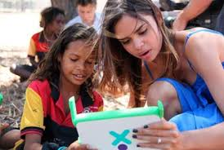
STANDARD 4
Equity is promoted and diversity is respected
Criterion 4.1 The entity actively anticipates children’s diverse circumstances and backgrounds, and provides support and responds effectively to those who are vulnerable.
Criterion 4.2 All children have access to information, support and complaint processes in ways that are culturally safe, accessible and easy to understand.
Criterion 4.3 The entity pays particular attention to the needs of Aboriginal and Torres Strait Islander children, children with disability, and children from culturally and linguistically diverse backgrounds, those who are unable to live at home, and children of diverse sexuality.

Slide 8
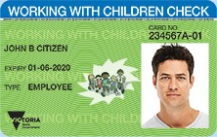
STANDARD 5
Robust human resource management
Criterion 5.1 Recruitment, including advertising, interview questions, referee checks and pre-employment screening, emphasises child safeguarding
Criterion 5.2 Relevant personnel (including all seminarians, clergy and religious) have current working with children checks or equivalent background checks.
Criterion 5.3 Personnel receive an appropriate induction and are aware of their child safeguarding responsibilities, including reporting obligations.
Criterion 5.4 Ongoing supervision and people management is focussed on child safeguarding.

Slide 9
STANDARD 5
Robust human resource management – part 2
Criterion 5.5 Robust processes exist for screening candidates before and during seminary and religious formation. Robust processes are implemented for ongoing formation, support and supervision of clergy and religious.
Criterion 5.6 Seminary and formation programs for clergy and religious have curriculum to build the knowledge and skills of candidates to understand and lead child safeguarding initiatives.
Criterion 5.7 Credentialing and movement of seminarians, clergy and religious is appropriately managed.
Criterion 5.8 Entities which receive overseas clergy and religious for work in ministry have targeted programs for the screening, induction, professional supervision and development of these individuals.

Slide 10
STANDARD 6
Effective complaints management
Criterion 6.1 The entity has an effective Complaints Handling Policy and procedures which clearly outline the roles and responsibilities, approaches to dealing with different types pf complaints, reporting obligations and record keeping requirements
Criterion 6.2 The entity has a child-focused complaints handling system that is understood by children, families, carers and personnel.
Criterion 6.3 Complaints are taken seriously, and responded to promptly and thoroughly

Slide 11
STANDARD 6
Effective complaints management (part 2)
Criterion 6.4 The entity has policies and procedures in place that address reporting of concerns and complaints to relevant authorities, whether or not the law requires reporting, and cooperates with law enforcement.
Criterion 6.5 Reporting, privacy and employment law obligations are met.
Criterion 6.6 The Church authority ensures mechanism are in place to care for adult complainants.
Criterion 6.7 The Church Authority ensues mechanisms are in place to monitor and support respondents facing allegations.

Slide 12
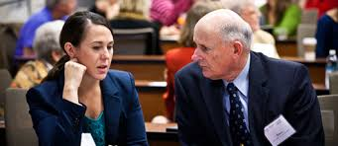
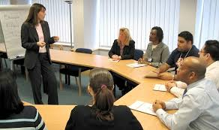
STANDARD 7
Ongoing education and training
Criterion 7.1 Personnel are trained and supported to effectively implement the entity’s child safeguarding policies and procedures.
Criterion 7.2 Personnel receive training to recognise the nature and indicators of child abuse, including harmful behaviours by a child towards another child.
Criterion 7.3 Personnel receive training and information to enable them to respond effectively to child safeguarding risks, concerns, disclosures and allegations of child abuse.
Criterion 7.4 Personnel receive training and information on how to build culturally safe environments for children.

Slide 13
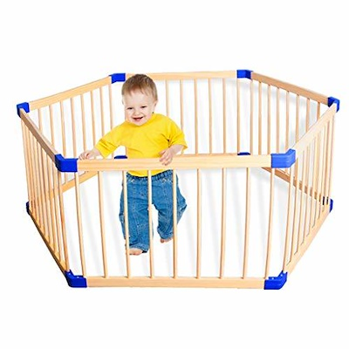
STANDARD 8
Safe physical and online environments
Criterion 8.1 Personnel identify and mitigate risks in online and physical environments without compromising a child’s right to privacy, access to information, social connections and learning opportunities.
Criterion 8.2 The online environment is used in accordance with the entity’s Code of Conduct and safeguarding policies and procedures.
Criterion 8.3 Risk management plans consider risks posed by the entity’s settings, activities and physical environments.
Criterion 8.4 Entities that contract facilities and services to and from third parties have procurement policies that ensure safeguarding of children.

Slide 14
STANDARD 9
Continuous improvement (regularly review and improve)
Criterion 9.1 The entity regularly reviews and improves child safeguarding practices.
Criterion 9.2 The entity analyses concerns and complaints to identify causes and systematic failures to inform continuous improvement.
Criterion 9.3 The Church Authority reports on the findings of relevant reviews to personnel, children, families, carers and community.

Slide 15
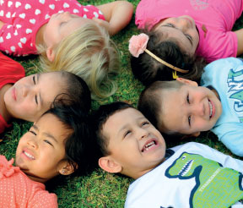
STANDARD 10
Policies and procedures support child safety
Criterion 10.1 Policies and procedures address the National Catholic Safeguarding Standards.
Criterion 10.2 Policies and procedures are accessible and easy to understand.
Criterion 10.3 Best practice policy models and stakeholder consultation inform the development and review of policies and procedures.
Criterion 10.4 The Church Authority and leaders champion and model compliance with policies and procedures.
Criterion 10.5 Personnel understand and implement the policies and procedures.

Slide 16
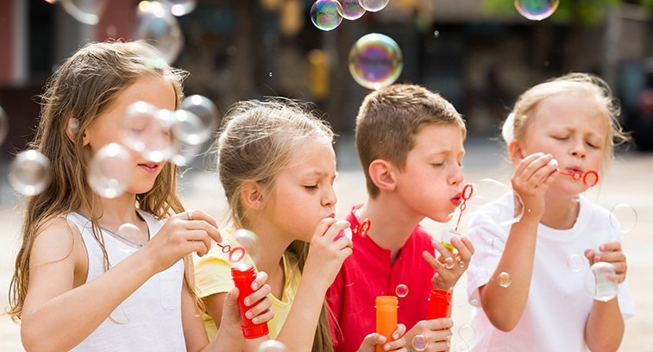

Slide 17
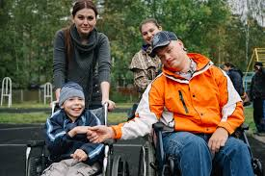
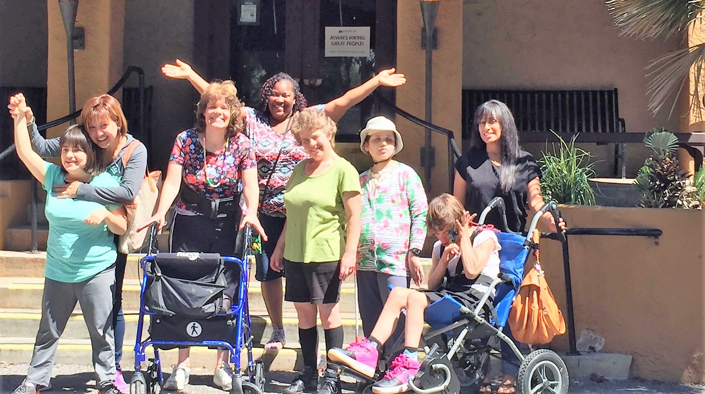

Slide 18
Vulnerable people can include:
children and seniors
people with impaired intellectual or physical functioning
people from a low socio-economic background
people who are Aboriginal or Torres Strait Islanders
people who are not native speakers of the local language
people with low levels of literacy or education
people subject to modern slavery, which involves human exploitation and control, such as forced labour, debt bondage, human trafficking, and child labour.
https://www.acnc.gov.au/for-charities/manage-your-charity/governance-hub/governance-toolkit/governance-toolkit-safeguarding (accessed 17 November 2019)

