Slide 1

Utilising Osmer’s Practical Theological Loop and Mutual Critical Correlation in Field Education to Develop Reflective Practitioners.
ian.hussey@malyon.edu.au

Slide 2
Osmer's Loop
Descriptive
“What is going on?
Normative
“What ought be going on?”
Interpretive
“Why is it going on?”
Pragmatic
“How might we respond?”

Slide 3
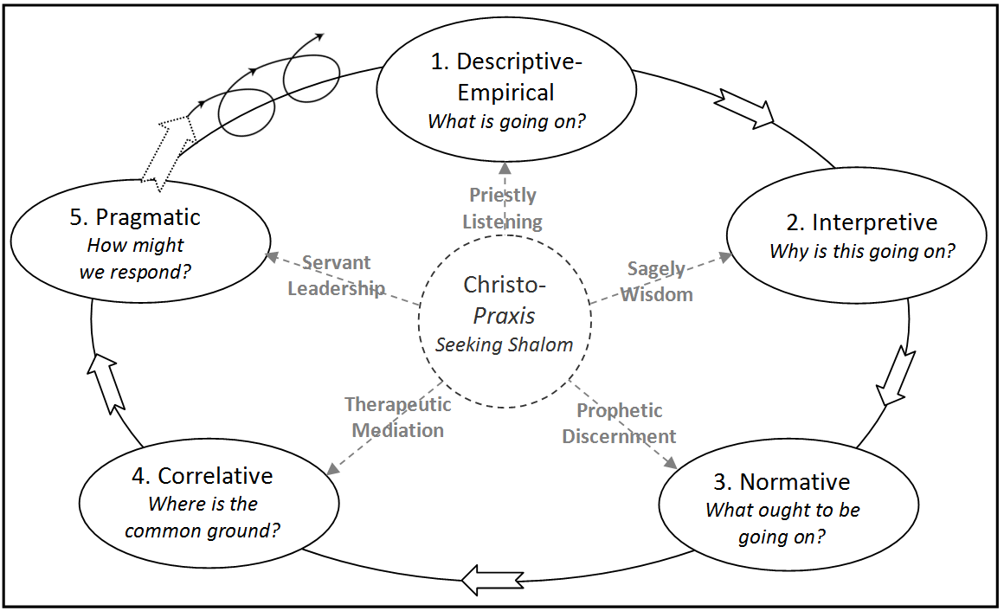
Benson's Five Movement Method

Slide 4
The Five Movements
Descriptive
The Contextual Question
The Reflexive Question
The Perspective Question
What was the context of this issue or event?
What baggage am I bringing to this issue or event?
How would others see this issue or event?

Slide 5
The Five Movements
Interpretive
The Social Science Question
The Elder Question
The Social Sciences
What wisdom from social science can help explain what is going on?
What wisdom from elders can help explain what is going on?
Congregational Research
Personal Research

Slide 6
The Five Movements
Normative
Scripture
The Theology Question
The Tradition/History Question
The Exemplar Question
Systematics
How can theology inform what ought to be happening?
How do exemplars inform what ought to be happening?
Ethics
How can church tradition/history inform what ought to be happening?
Salvation History
Feminist, majority-world and minority perspectives

Slide 7
The Five Movements
Correlative
Interpretive
Normative
The Affirmative Question
The Challenge Question
The Synergy Question
How do the movements affirm one another?
How do the movements challenge one another?
How do the movements build on one another?

Slide 8
The Five Movements
Pragmatic
The Orthopraxy Question
The Action Steps Question
The Ethical Question
The Formation Question
What is orthopraxy relating to this ministry issue or event?
What are two specific action steps that can be taken towards orthopraxy?
What is professional, safe and ethical practice in implementing these action steps?
How have I been formed into the image of Christ through this exercise in Practical Theology?

